Slide 1

Sir Syed University of Engineering & Technology, Karachi
CS-468 Software Quality Assurance & Testing
Week 7
Session 2

Slide 2
Decision Tables …
A decision table is an excellent tool to use in both testing and requirements management.
Essentially it is a structured exercise to formulate requirements when dealing with complex business rules.
Decision tables are used to model complicated logic.
They can make it easy to see that all possible combinations of conditions have been considered and when conditions are missed, it is easy to see this.
In a decision table, conditions are usually expressed as true (T) or false (F).
Each column in the table corresponds to a rule in the business logic that describes the unique combination of circumstances that will result in the actions.
It is normal to create at least one test case per column, which results in full coverage of all business rules.

Slide 3
… Decision Tables …
One advantage of using decision tables is that they make it possible to detect combinations of conditions that would otherwise not have been found and therefore not tested or developed.
The requirements become much clearer and you often realize that some requirements are illogical, something that is hard to see when the requirements are only expressed in text.
A disadvantage of the technique is that a decision table is not equivalent to complete test cases containing step-by-step instructions of what to do in what order.
When this level of detail is required, the decision table has to be further detailed into test cases.

Slide 4
… Decision Tables …
Decision tables can be used in all situations where the outcome depends on the combinations of different choices, and that is usually very often.
In many systems there are tons of business rules where decision tables add a lot of value.
Decision tables should best be constructed during system design, since they become useful to both developers and testers.
The requirements specialist also becomes more confident that everything that is important is actually documented.
If there are no decision tables, testers can create them during test design to be able to write better test cases.

Slide 5
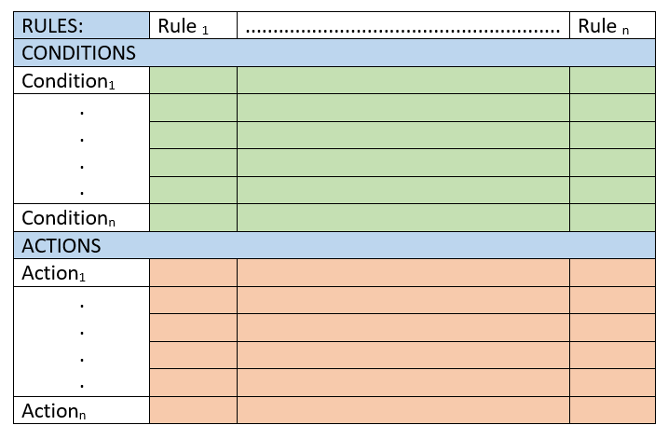
… Decision Tables …

Slide 6
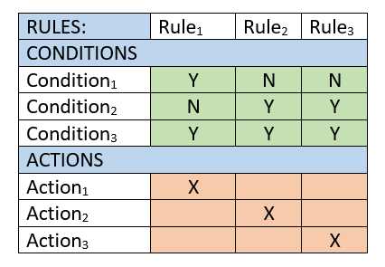
… Decision Tables …

Slide 7
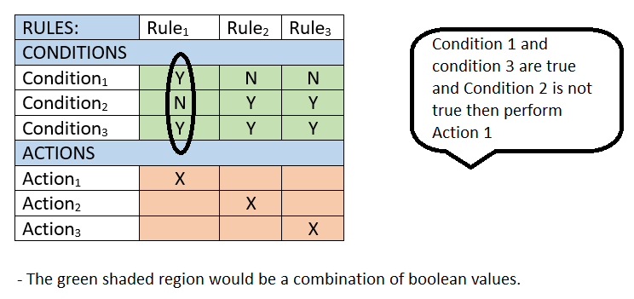
… Decision Tables …

Slide 8
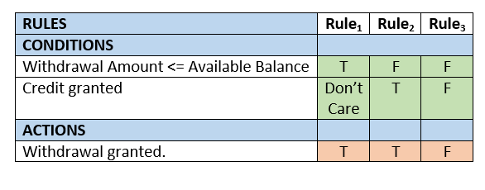
Decision Tables – Example 1
A customer requests a cash withdrawal. One of the business rules for the ATM is that the ATM machine pays out the amount if the customer has sufficient funds in their account or if the customer has the credit granted.

Slide 9
Decision Tables – Example 2 ...
A mutual insurance company has decided to float its shares on the stock exchange and is offering its members rewards for their past custom at the time of flotation. Anyone with a current policy will benefit provided it is a ‘with-profits’ policy and they have held it since 2001. Those who meet these criteria can opt for either a cash payment or an allocation of shares in the new company; those who have held a qualifying policy for less than the required time will be eligible for a cash payment but not for shares. Generate decision table for the scenario.

Slide 10
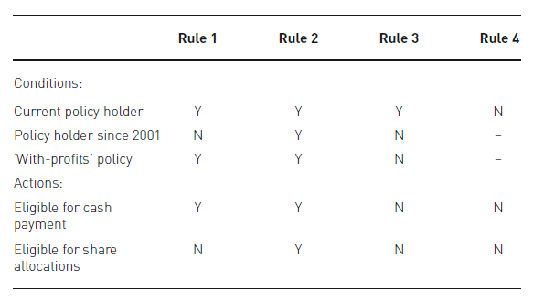
... Decision Tables – Example 2
Billy will be eligible for a cash payment but not for a share allocation.

